Slide 1
Digital Portfolio
STUDENT NAME: K.JAYASRI
REGISTER NO AND NMID: 212401008/86B877C29BCEAC08A11457FA2B442B48
DEPARTMENT: COMPUTER APPLICATION
COLLEGE:UNIVERSITY OF MADRAS

Slide 2
PROJECT TITLE
DIGITAL PORTFOLIO USING FRONT END WEB DEVELOPMENT

Slide 3


AGENDA
Problem Statement
Project Overview
End Users
Tools and Technologies
Portfolio design and Layout
Features and Functionality
Results and Screenshots
Conclusion
Github Link
3/21/2024 Annual Review

Slide 4

PROBLEM STATEMENT
In today’s competitive digital era, professionals and students face challenges in effectively showcasing their skills, projects, and achievements in a way that is both accessible and visually appealing. Traditional resumes or static documents often fail to reflect an individual’s creativity, technical expertise, and personal brand. As a result, there is a growing need for an interactive and well-structured portfolio that not only highlights one’s work but also provides an engaging experience for potential employers, clients, or academic evaluators. A digital portfolio serves as a dynamic solution to bridge this gap by presenting information in an organized, attractive, and user-friendly format.

Slide 5

PROJECT OVERVIEW
The portfolio project is designed to create a professional digital space that showcases an individual’s skills, achievements, and creative works in an organized and visually appealing manner. It serves as a personal branding tool where users can highlight their educational background, technical expertise, projects, certifications, and experiences in a structured format.

Slide 6

WHO ARE THE END USERS?
The end users of a portfolio include potential employers, recruiters, clients, academic evaluators, and peers who wish to assess an individual’s skills, creativity, and professional achievements. For job seekers, the portfolio acts as a medium to demonstrate expertise and stand out in the competitive job market. For students and fresh graduates, it provides a platform to showcase academic projects, certifications, and internships to faculty members or hiring managers.

Slide 7

TOOLS AND TECHNIQUES
The development of a digital portfolio involves the use of various tools and techniques to ensure it is both functional and visually appealing. Commonly used tools include HTML, CSS, and JavaScript for front-end design, along with frameworks like React or Bootstrap for creating responsive and interactive layouts. Backend technologies such as Node.js, PHP, or Firebase may be used for data handling and form submissions, while databases like MySQL or MongoDB help in storing project or user information. Design tools such as Figma, Canva, or Adobe XD support the creation of wireframes, mockups, and graphic elements to enhance visual presentation.

Slide 8
POTFOLIO DESIGN AND LAYOUT
The design and layout of the portfolio are created with a focus on simplicity, clarity, and professionalism to ensure that information is presented in an organized and visually appealing manner. A clean and responsive layout is adopted so that the portfolio is easily accessible across different devices such as desktops, tablets, and mobile phones. The homepage serves as an introduction with a brief profile or personal statement, followed by well-structured sections such as About Me, Skills, Projects, Achievements, and Contact Information. Visual hierarchy, typography, and color schemes are carefully chosen to enhance readability and create a lasting impression.
8

Slide 9
FEATURES AND FUNCTIONALITY
The portfolio is equipped with a range of features and functionalities that enhance both usability and user engagement. It typically includes a well-structured navigation system for easy access to different sections such as About, Skills, Projects, Certifications, and Contact. Interactive project showcases with images, descriptions, and live demo or GitHub links allow visitors to explore the creator’s work in detail. A responsive design ensures compatibility across devices and screen sizes, while contact forms or integrated email links provide direct communication channels.

Slide 10
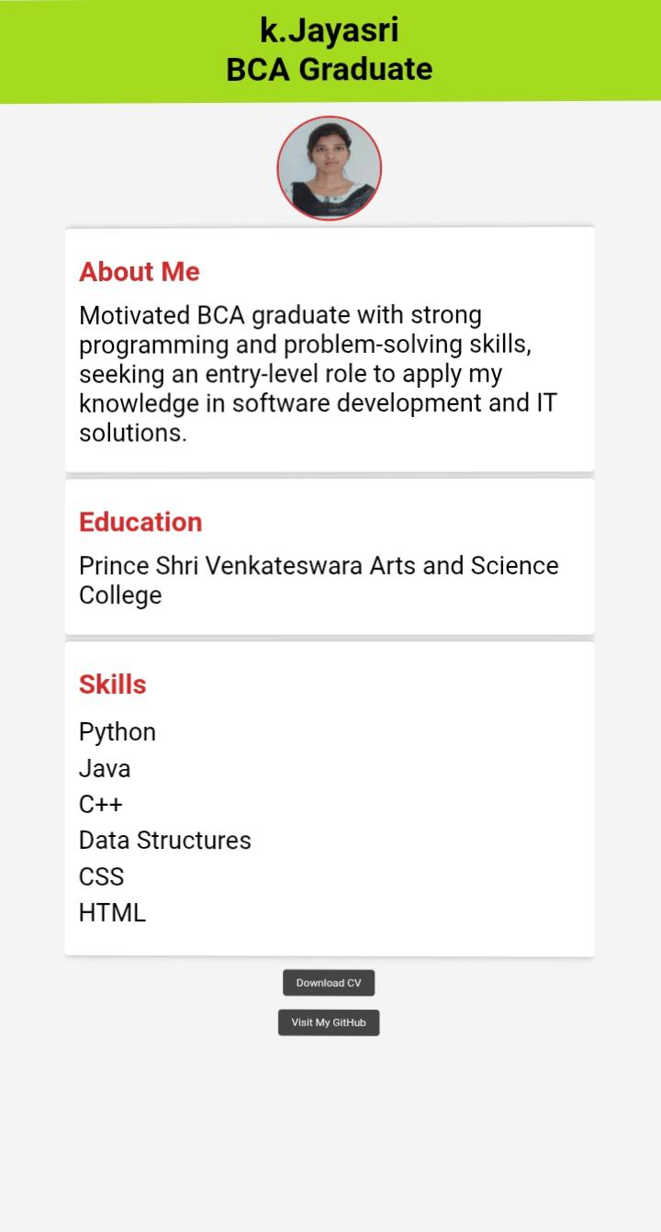

RESULTS AND SCREENSHOTS
The portfolio project resulted in a fully functional, visually appealing, and user-friendly digital platform that effectively highlights personal skills, projects, and achievements.
3/21/2024 Annual Review
10

Slide 11
CONCLUSION
In conclusion, the portfolio project serves as an effective digital platform for showcasing personal and professional achievements in a structured and visually appealing way. By integrating modern design principles, responsive layouts, and interactive features, the portfolio not only enhances self-presentation but also provides easy accessibility for potential employers, clients, and academic evaluators.
11

Slide 12
GitHub link
GitHub link
https://github.com/KJayasri-bit/K.jayasri-portflio.git

